Slide 1
“Up Next”: Movie Suggestion Application
Logan Crooks, Allen Chang, Joel Foster

Slide 2
Outline of presentation
Application description
Implementation
Demonstration
Evaluation
Conclusion

Slide 3
Application domain and type
Stand-alone application
Java application, Swing library implemented
MySQL used to implement DB
Domain: Movies/Films
IMDB Dataset
Movie info, but also actor/actress info, and pertinent location info for related persons

Slide 4
Importance of domain
Important features:
Merging these datasets allows personal curation of movies (personal collection)
Get deeper than just movies by finding info about cast members
Get recommendations
View geographic location of people cast members

Slide 5
Application Description
Movie database management application
Handles movie, actor, and location info
Allows users to manage liked movies/actors, find recommendations, and additional peripheral info related to movies/actors
Included location info to see a map visual of where favorite actors are born

Slide 6
Implementation
Description of the general architecture. Please feel free to use any diagram, pictures.
Dataset
Describe the database (#tables, #records (max), any interesting highlights of these tables….)
Point to the demonstration of prototype

Slide 7
General ARCHITECTURE
User-facing
Java Swing Stand-Alone
CSV
MySQL
CSV
JDBC
Data
CSV

Slide 8
Datasets
All acquired from Kaggle
All in CSV form
IMDB Movies - contains information about movies that appear on IMDB website
IMDB Names - contains information about cast members
IMDB Ratings - contains information about movie ratings by gender and age group
World Cities - contains geographical information about all cities in the world

Slide 9
Datasets -By the numbers
https://www.kaggle.com/stefanoleone992/imdb-extensive-dataset?select=IMDb+movies.csv
https://www.kaggle.com/max-mind/world-cities-database?select=worldcitiespop.csv
Dataset | Number of columns | Number of rows
IMDB Movies | 22 | 81,273
IMDB Names | 20 | 175,715
IMDB Ratings | 49 | 81,273
World Cities | 7 | 2,375,760

Slide 10
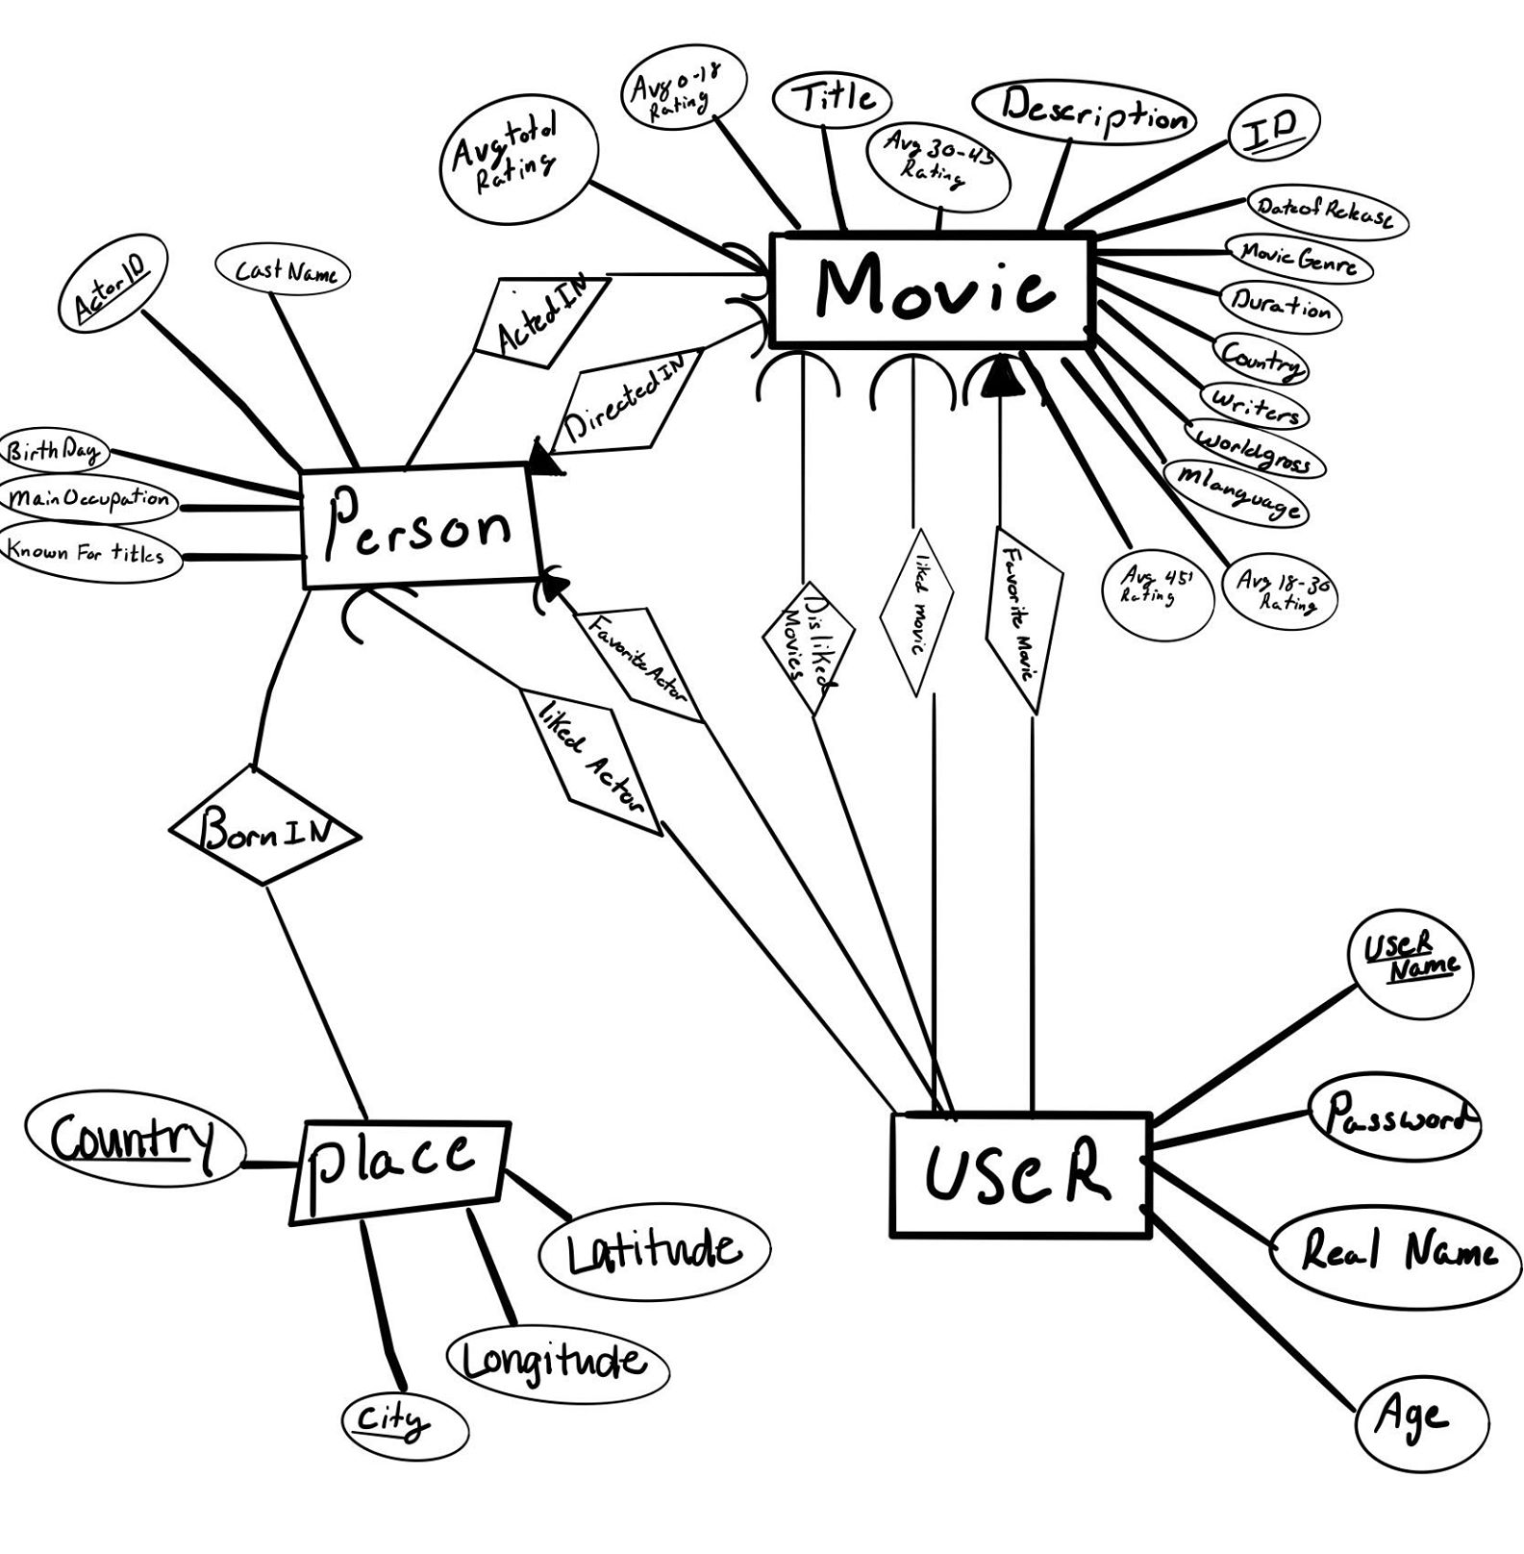
ER Diagram

Slide 11
Database
Tables - 11 in total
Movies
Person
ProgramUser
LikedMovie
LikedPeople
FavoritePerson
FavoriteMovie
DislikedMovie
Demographics (in progress)
BornIn (in progress)
WorkedOn (in progress)

Slide 12
Movies
Created table using LOAD DATA INFILE with IMDB Movies.csv
Very fast ~1 second
12 columns, 81,273 rows
Primary key ‘ID’ composed of 9 characters

Slide 13
Person
Experienced challenges making this table
Attempt to load in IMDB Names.csv
Problems - some entries are empty, some entries contain double quotes “”, bad characters
Code: FIELDS TERMINATED BY ',' ENCLOSED BY '"' LINES TERMINATED BY '\n'

Slide 14
Cleaning IMDB NAMEs dataset
Download Python 3
Use pandas library to edit CSV, specifically Dataframe
Removed unnecessary columns that had info we don’t need, replace empty entries with NULL
Final result - 6 columns, 175,716 rows
Primary key ‘ActorID’

Slide 15
Person
Final result - 6 columns, 175,716 rows
Primary key ‘ActorID’
Stores birthday/occupation/castname/birth place

Slide 16
ProgramUser
Stores all valid logins to our application
A new row is added each time a user signs up
There are 4 columns - username, userpassword, real name, age
Primary key (username,userpassword)
Size changing - users can create and delete accounts

Slide 17
Liked and favorite Tables
LikedPeople, LikedMovie, DislikedMovie, FavoriteMovie, FavoritePerson all very similar
Store information about user preferences to recommend movie
All have 3 columns - username, userpassword, ID(ID for movie, actorID for people)
Amount of rows constantly changing as user can add or remove from these tables

Slide 18
Primary Key constraints
For Liked tables, primary key is whole table.
One movie liked by many users, one user likes many movies
For Favorite tables, primary key is just username+password because each user only has one favorite

Slide 19
Foreign Key constraints
The tables reference both ProgramUsers and Movie or Person table
Movie must be valid movie and User must be valid user
Code - ON UPDATE CASCADE, ON DELETE CASCADE
User has option to change their usernames or passwords or even delete account
Rows corresponding to user deleted if user deleted, rows update username or password if user changes their settings

Slide 20
Demographics
Loaded in directly from IMDB Ratings.csv
81,273 rows and 6 columns
Contains ratings for each movie based on age group, therefore we can recommend movies based on user age
Primary key - ‘ID’ same as Movie table

Slide 21
Place
Use data from World Cities.csv
Issue: >2 million records, not all are needed, only the cities that a person was born in
Try to remove unneeded cities by joining with Person table
Based on size of Person, Place should have <=175,716 entries

Slide 22
Cleaning Place
Require country and city to be primary key
In World Cities.csv, some entries have same country and city name
End result should have 5 columns

Slide 23
BornIn - very difficult
Join Place and Person tables based on birth place
Problem - Person birth place is one attribute ‘Birthplace’ that lists City, Country while Place has two attributes ‘City’ and ‘Country’
Other problem - ‘Birthplace’ in Person uses full Country Name, while Place uses abbreviation

Slide 24
BorniN - solutions
Use Python to separate ‘Birthplace’ of Person into two columns by separating at the comma
Still not perfect - entries are not formatted cleanly some have parentheses listing additional info
Found another dataset with Country Name and Abbreviation
Join with this dataset to convert country name into it’s abbreviation

Slide 25
Workedon
Join Movie and Person tables to make a two column table of movie ID and actor ID to store which actor was in which movie
Two ways
Actor has ‘KnownForTitles’ attribute that has list of movie IDs
Movie has ‘listofActors’, ‘writer’, ‘director’
Both ways have an issue...

Slide 26
workedon problems
They require joining using LIKE instead of =
Equality search is much faster!
select count(*) from movie m, person p where m.director like concat('%',p.castname,'%'); | select count(*) from movie m, person p where m.director=p.castname;
The above query took 2,452.906 seconds! | The above query took 0.907 seconds!

Slide 27
temporary solution
When given a movie, use Java to remove whitespace and separate ‘listofactors’ attribute by comma into String[]
Do equality search on each entry in string array to find the corresponding row in Person
Works given a small list of movies

Slide 28
Permanent solution
Find better way to make table WorkedOn OR wait a very long time…
Ran for 50 minutes before losing connection

Slide 29
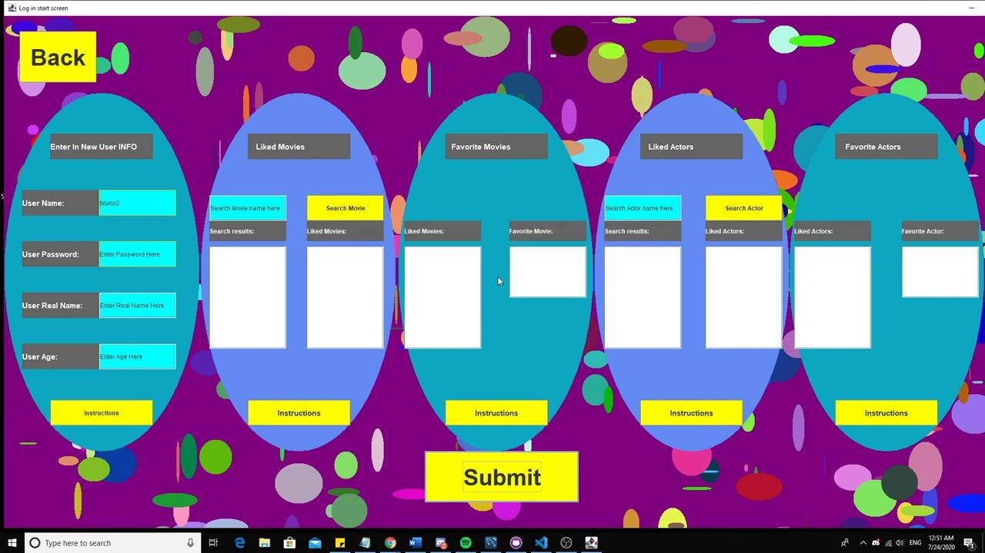
Video

Slide 30
Evaluation
Assessment/evaluation conducted with this application

Slide 31
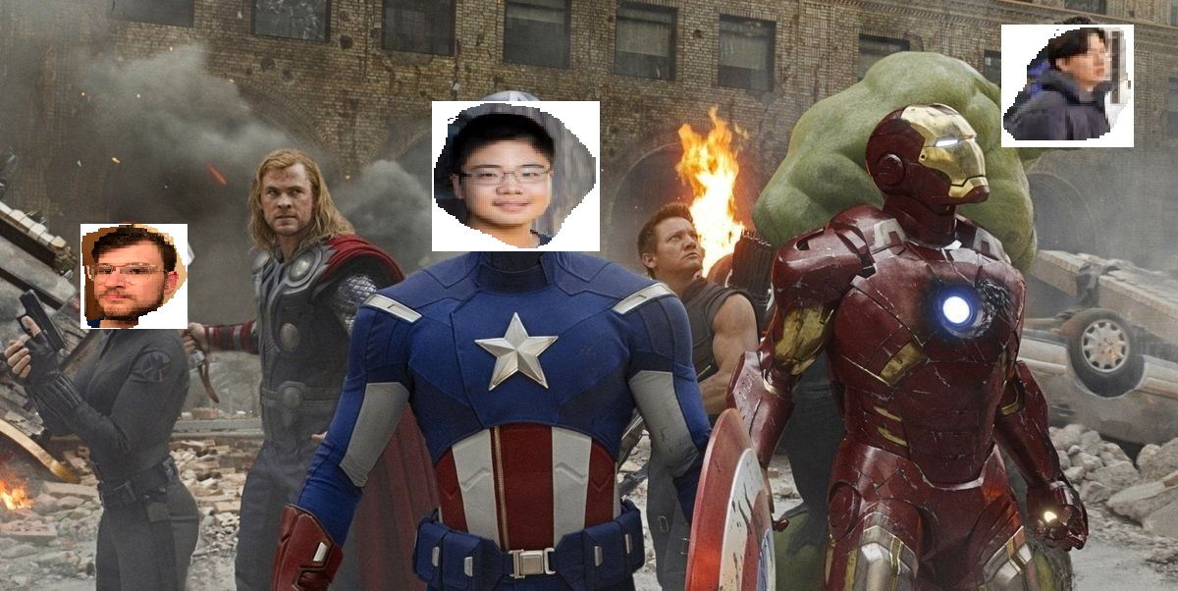
The First Wave Testers
WE ARE THE FIRST DEFENDERS
We are The First Bug Testers

Slide 32
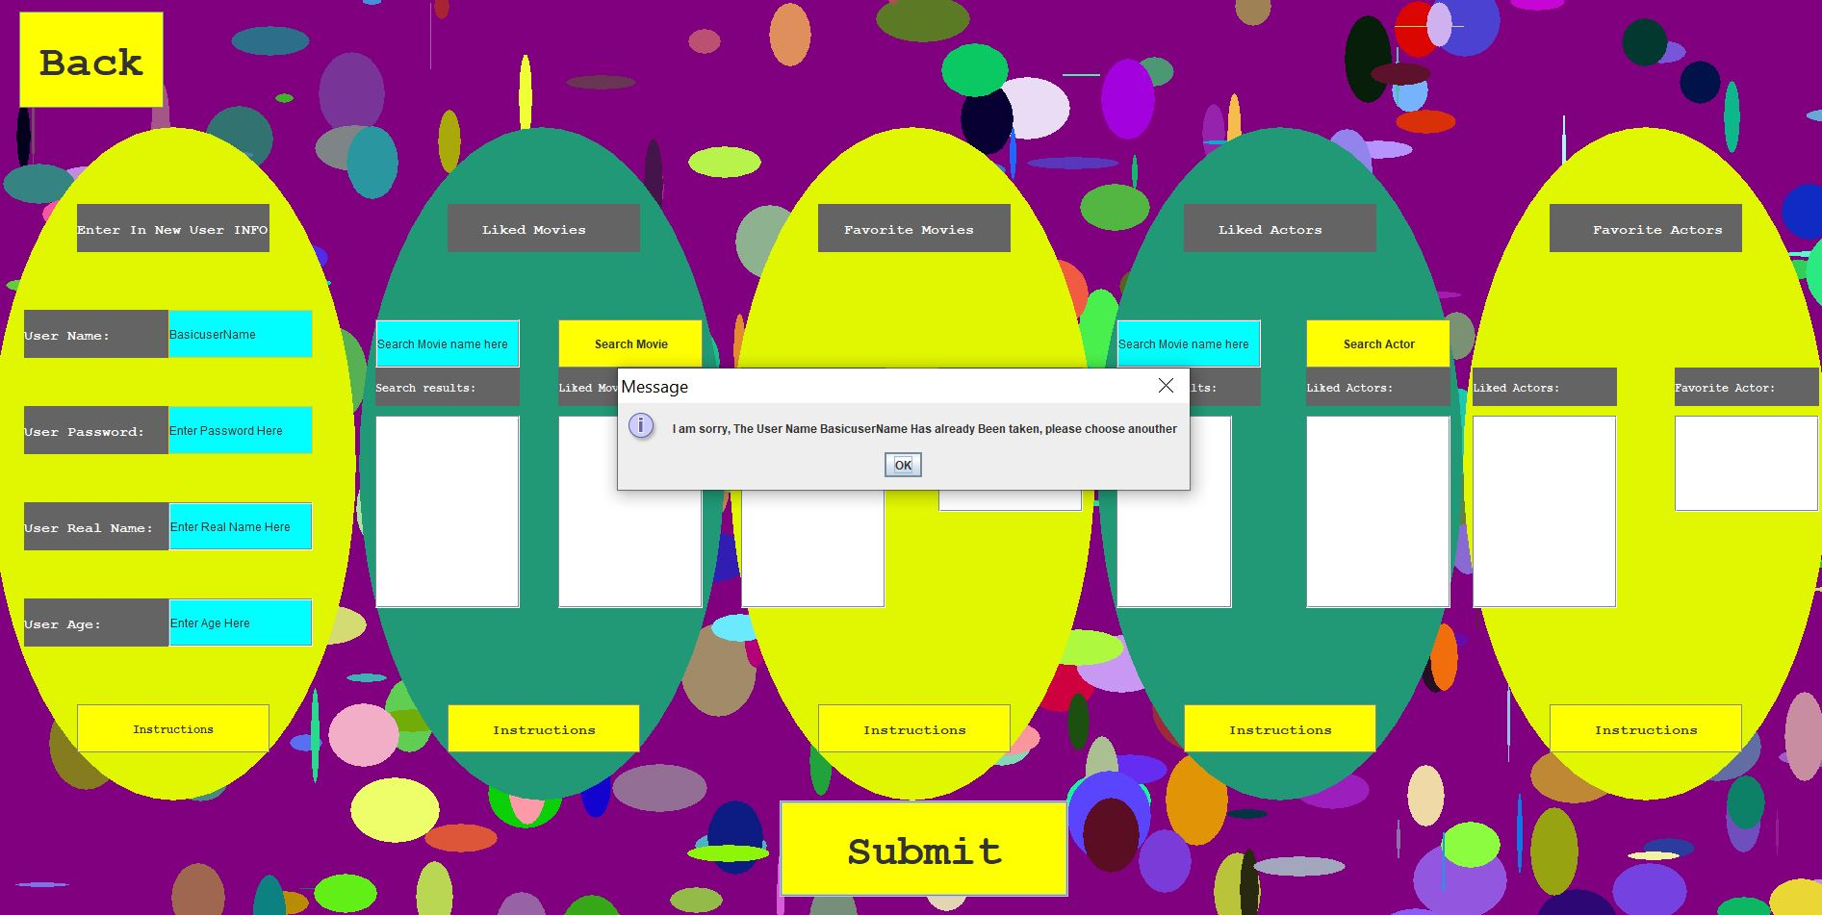
Base case of Bug Implementation
User Tries to Create an account with an already taken username

Slide 33
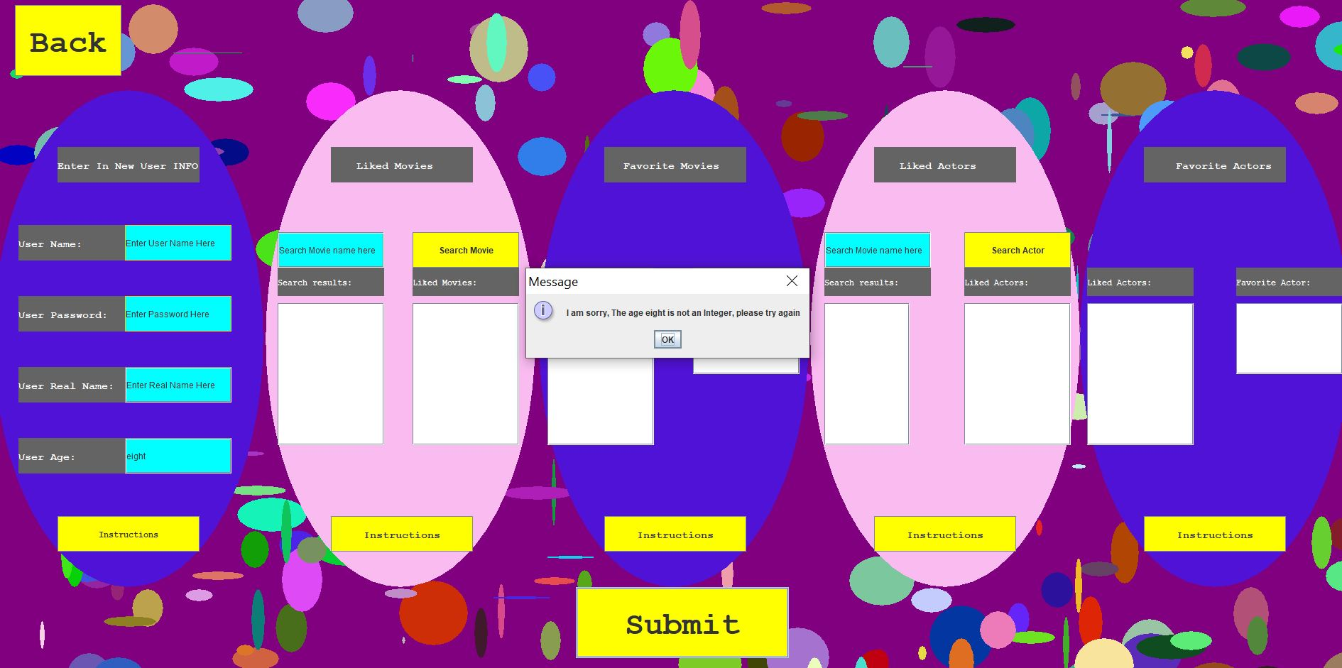
Base case of Bug Implementation
The age entered was not an Integer

Slide 34
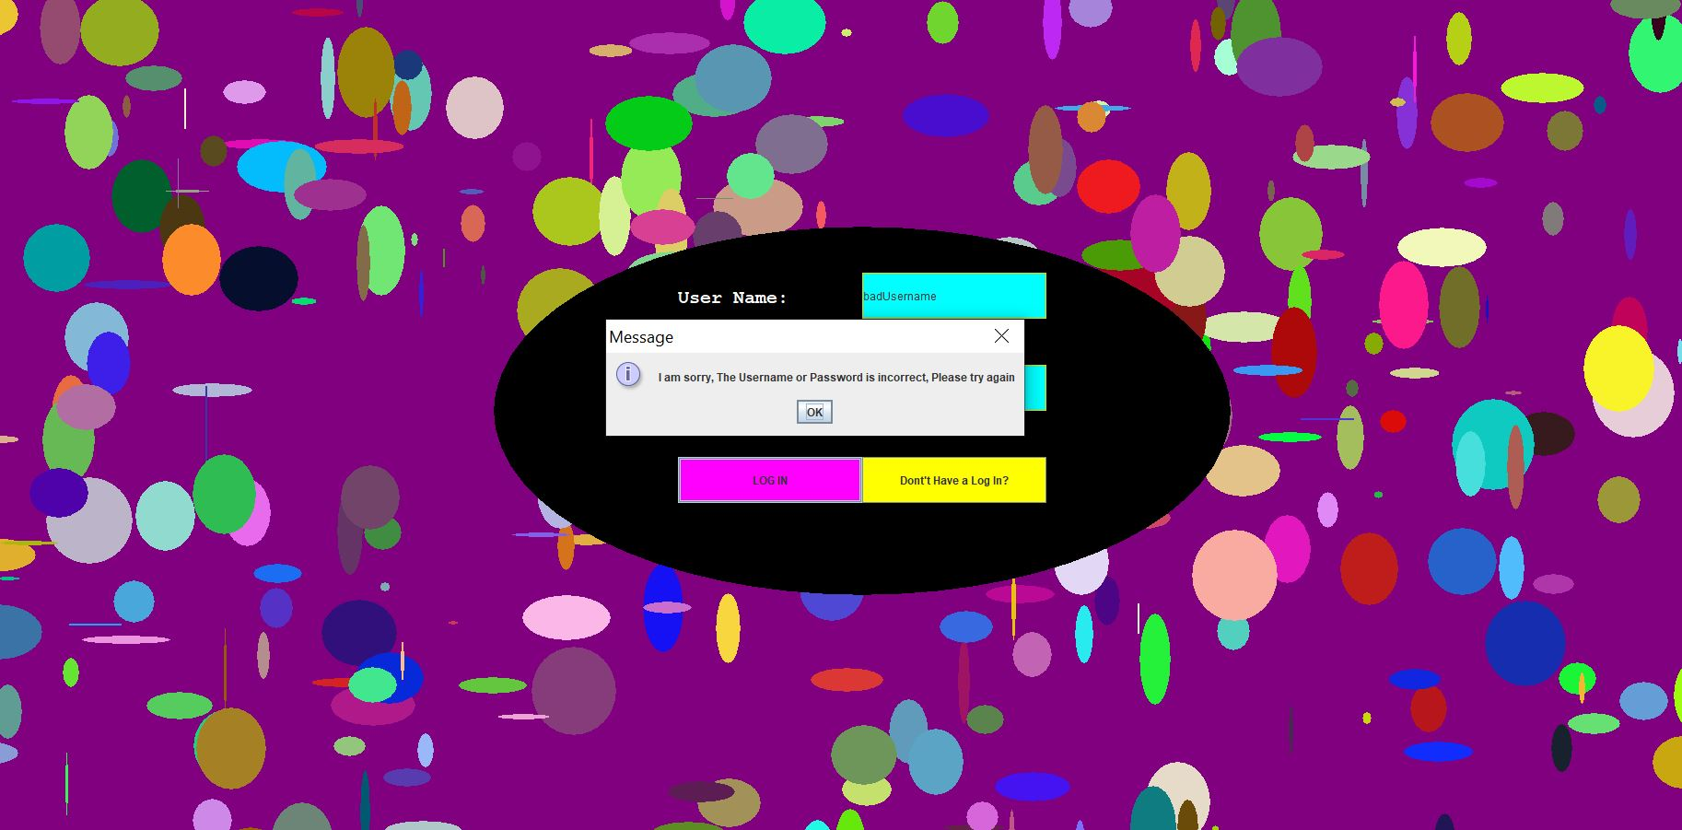
Base case of Bug Implementation
The User Attempts to Log in with an invalid Username or Password

Slide 35
Some other Thing tested
The User attempts to add a Favorite Movie/actor when they already have a favorite movie/actor
Attempted to add an actor to liked list from a suggested Movie
Add a Movie to liked list from a suggested movie list
Removed liked/favorite movie/actor in user settings
Delete User Account

Slide 36
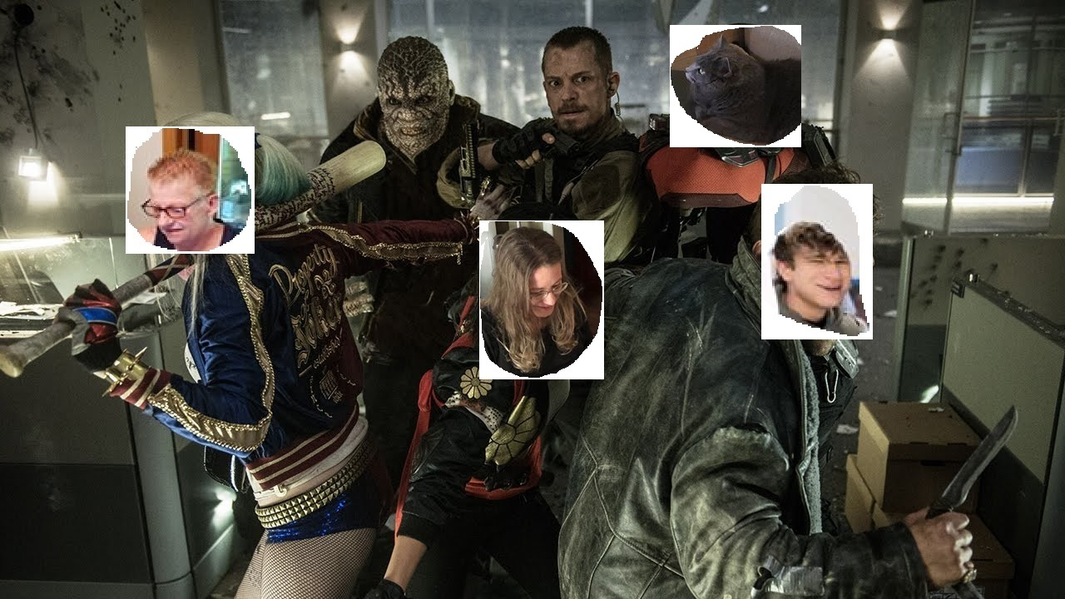
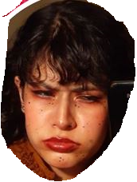
MEET The Beta Testers

Slide 37
Ratings Among Age Groups
Initial Ratings
Ratings*-REMASTERED-*
Younglings: 4 out of 5
College: 3.8 out of 5
The parents 4.2 out of 5
The old People 3.1 out of 5
The cats .6 out of 5
Younglings: 5 out of 5
College: 5 out of 5
The parents 5 out of 5
The old People 4.8 out of 5
The cats .3 out of 5

Slide 38
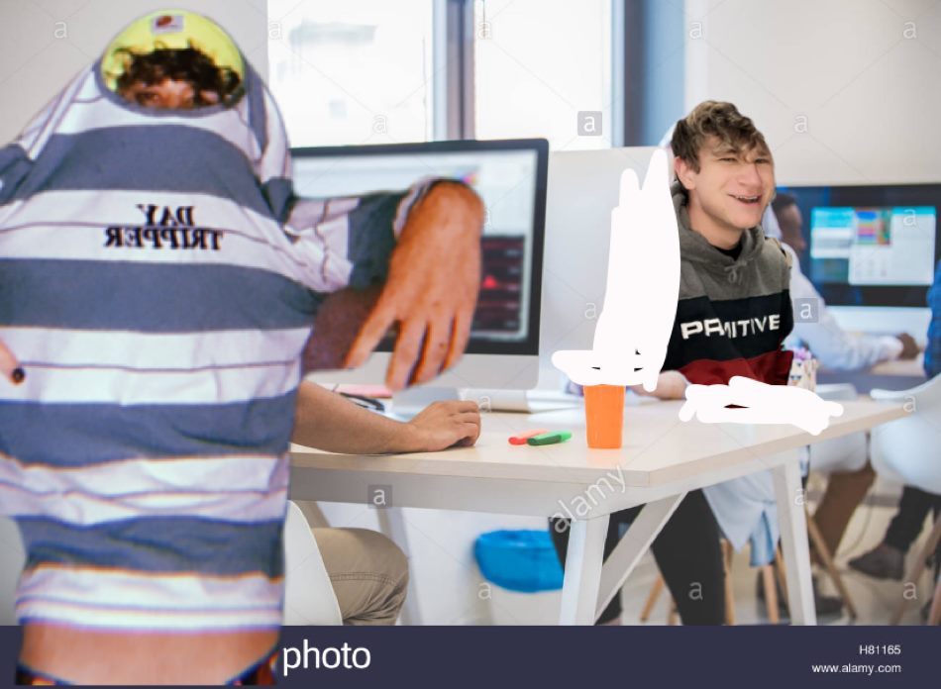
Let's take a Look at the Younglings
“I gave it 4 out of 5 stars because the map was cool but I had some difficulty coming up with liked actors and Movies when creating a new account”-Nathan
Note: this is an accurate recreating of a Youngling (Logan’s Brother) interacting with the programv

Slide 39
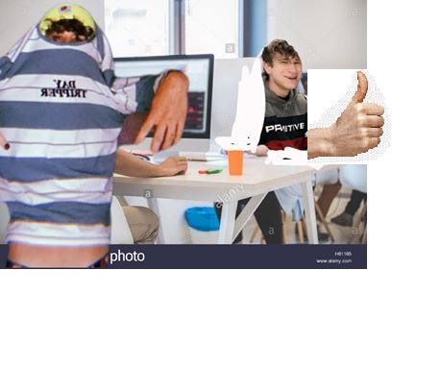
What did we do to With Nathan’s FeedBack?
We made it so when creating a new user, that user does not need pick actors or movies. The movie recommender will just randomly recommend movies until it gets a grasp on what the user enjoys

Slide 40
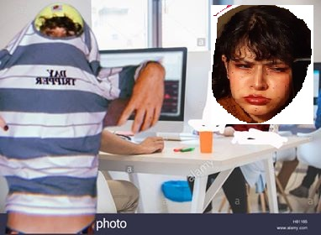
Let's take a Look at the college Students
“I think the 3.8 is pretty good, because what does this have to offer over something like Netflixs Database?”
-Beatrice
Note: this is an accurate recreating of a College student (Logan’s friend) interacting with the programv

Slide 41
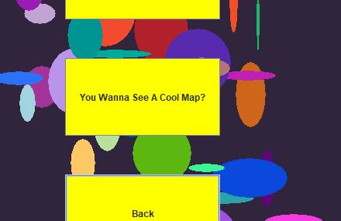
What did we do to With Beatrice’s Feedback?
After More of a conversation we realized she did not even come across the map. So we labeled the map button to pique someone's curiosity

Slide 42
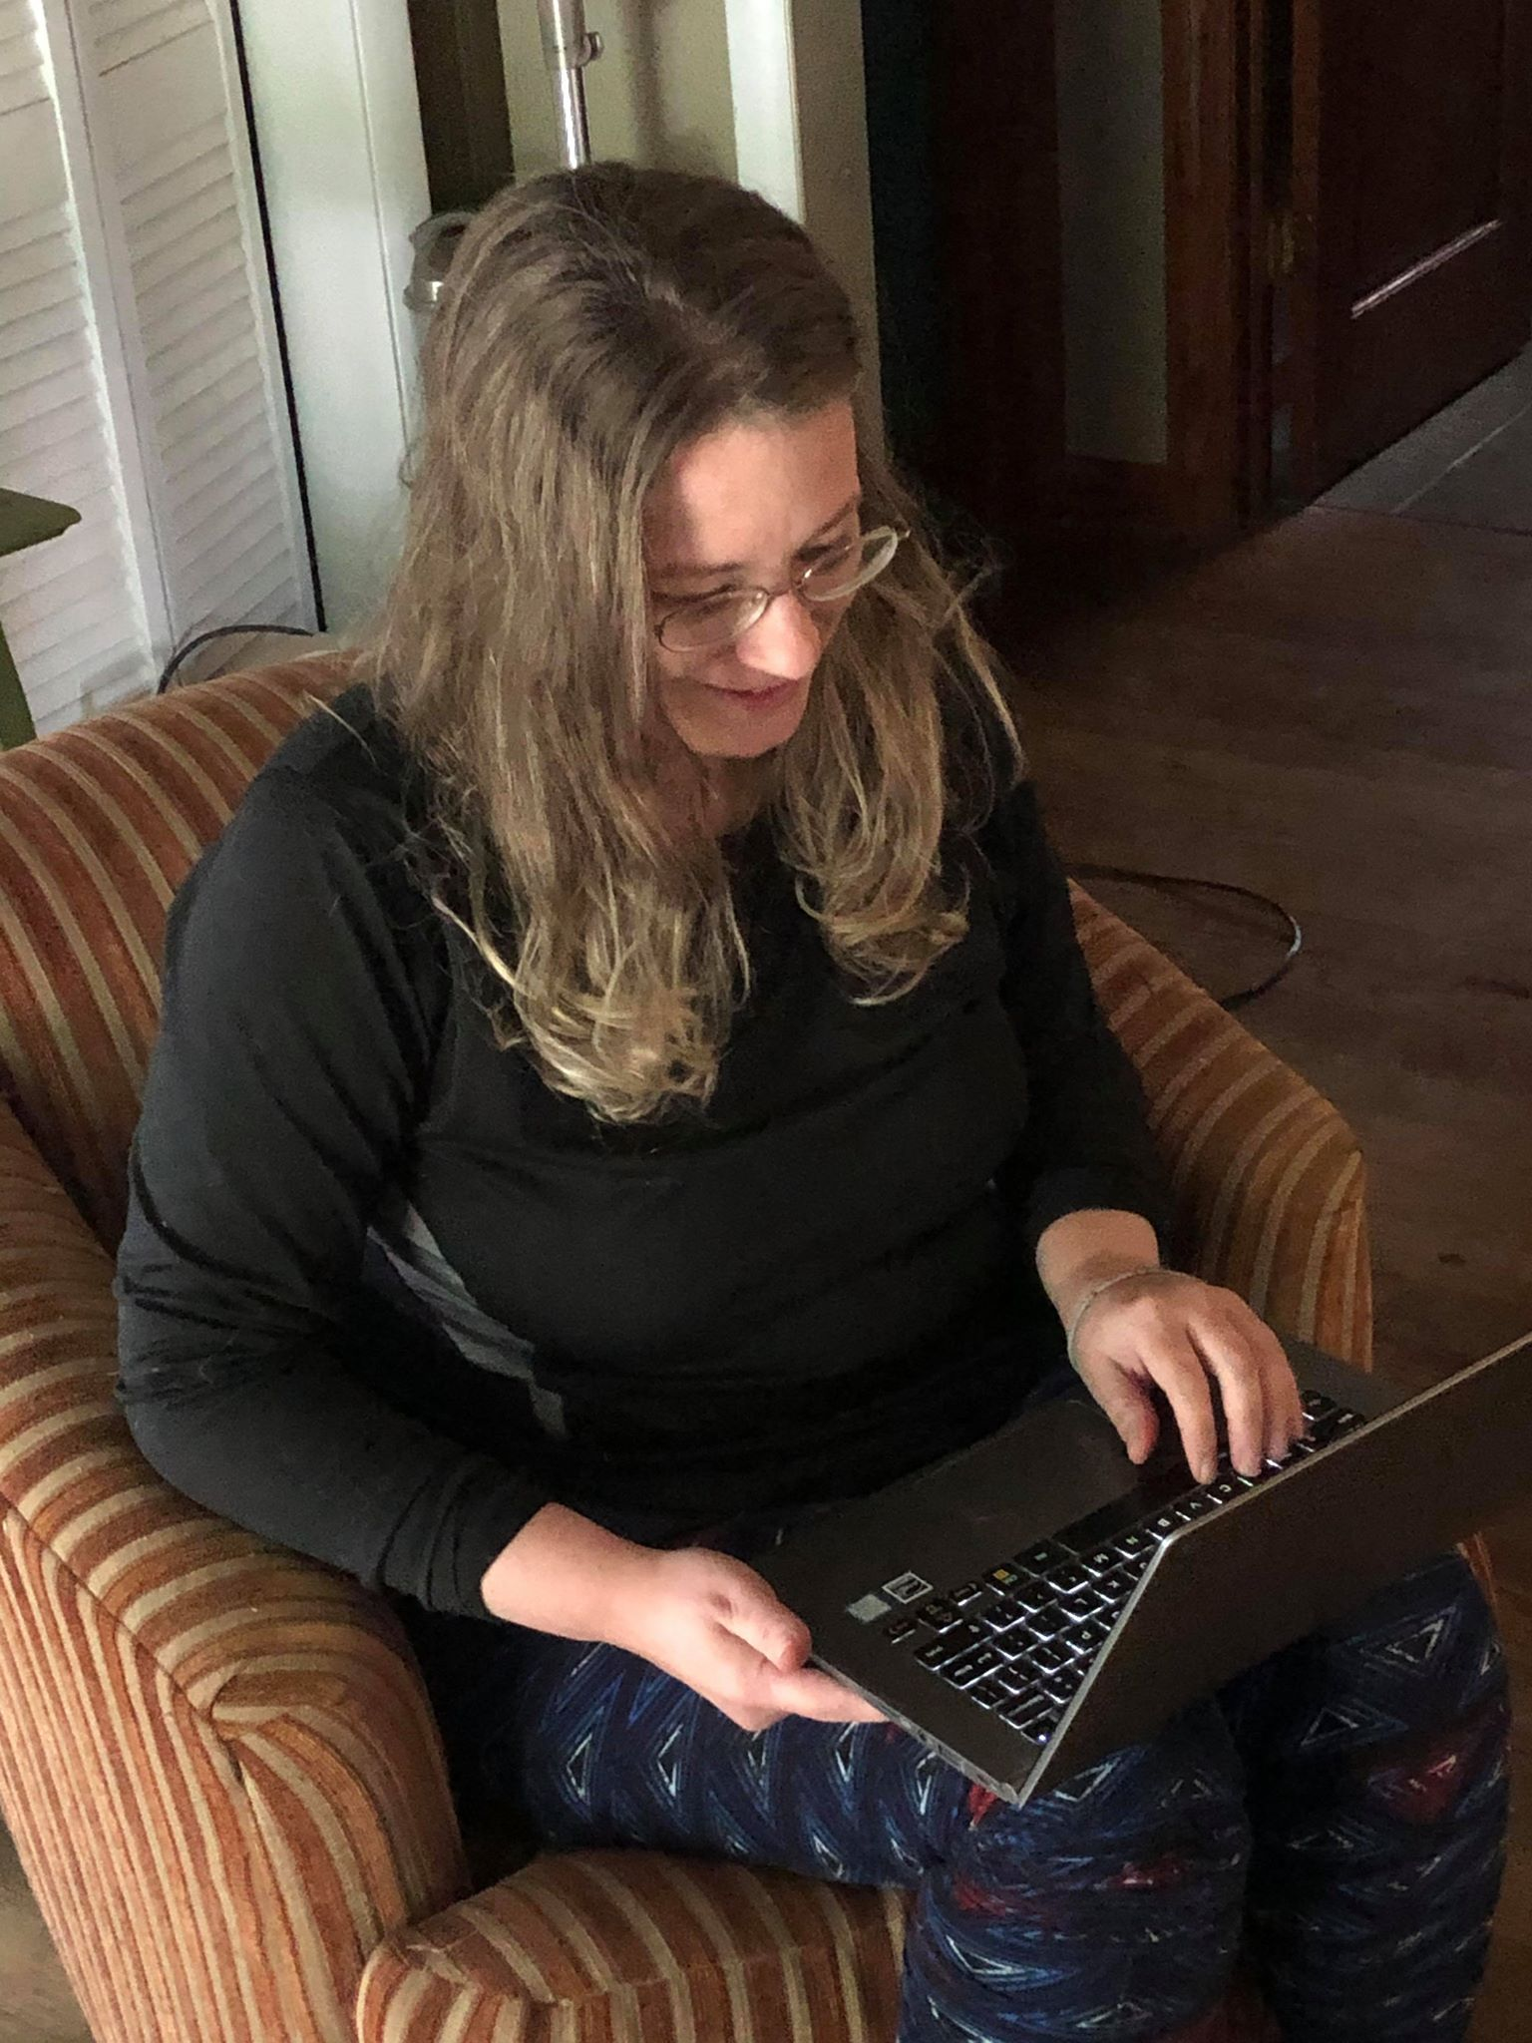
Let's take a Look at the Parents
“I gave it 4.2 because We couldn’t add more than one favorite? I was just repeatedly clicking trying to add another favorite movie and nothing happened” - Rosella

Slide 43
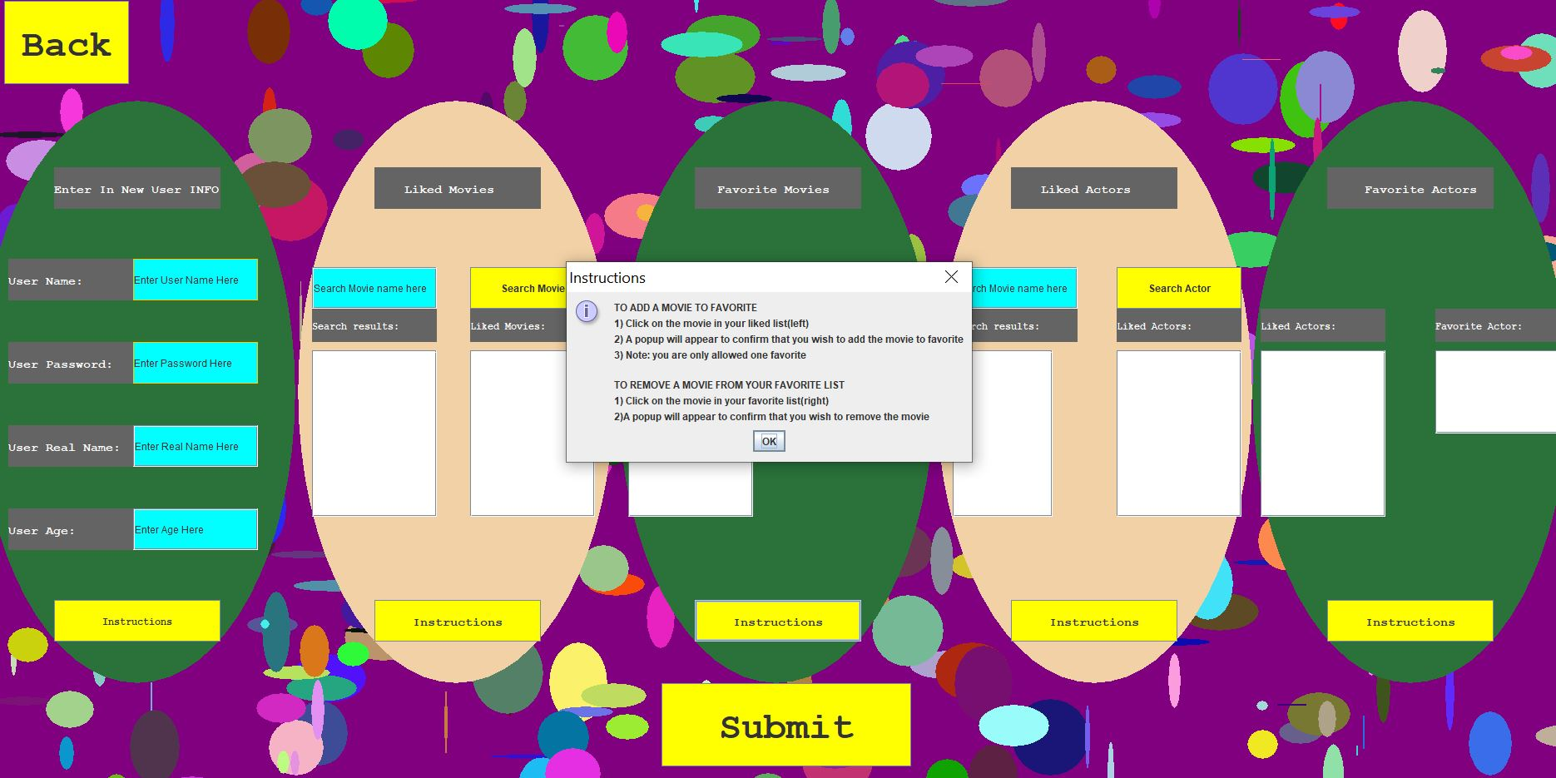
what did we do to With Rosella’s Feedback?
We added a few instruction buttons (this was also very important to the old people)

Slide 44
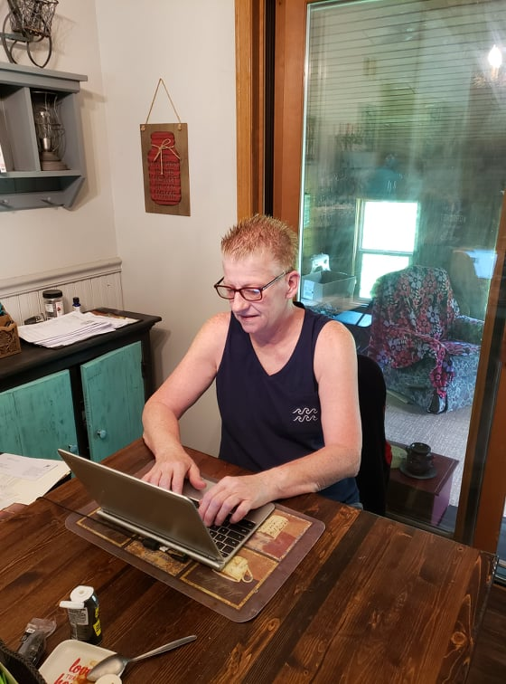
Let's take a Look at the GrandParents
“I gave it a 3.1 because I Liked the shapes and the buttons, but for the life of Me I could not figure out what to do and also the text was kinda small”-Cindy

Slide 45
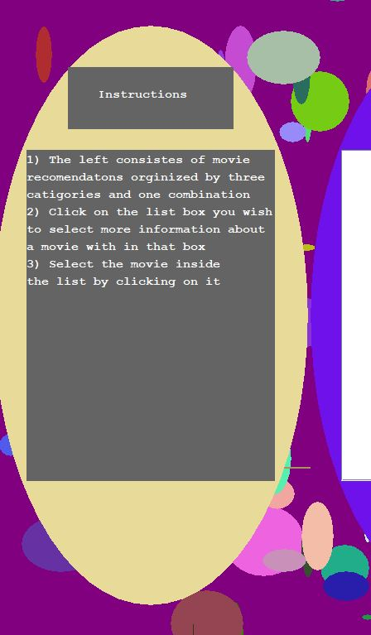
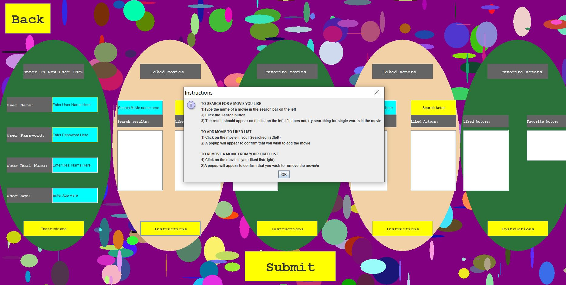
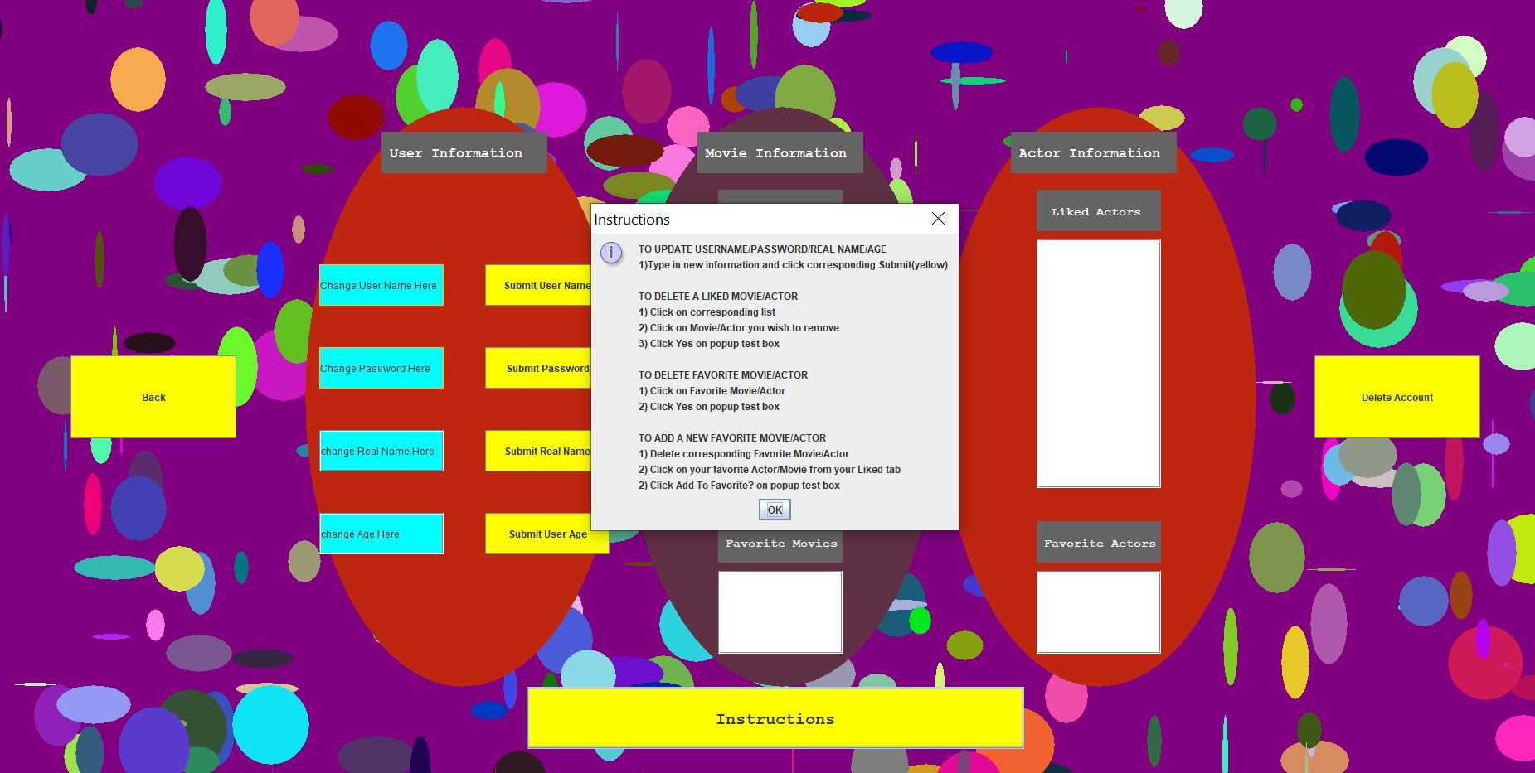
what did we do to With Cindy’s Feedback?
We add instructions everywhere. Every Screen has some sort of instructions or explanation on what the page is.
We also increased the text size every location possible

Slide 46
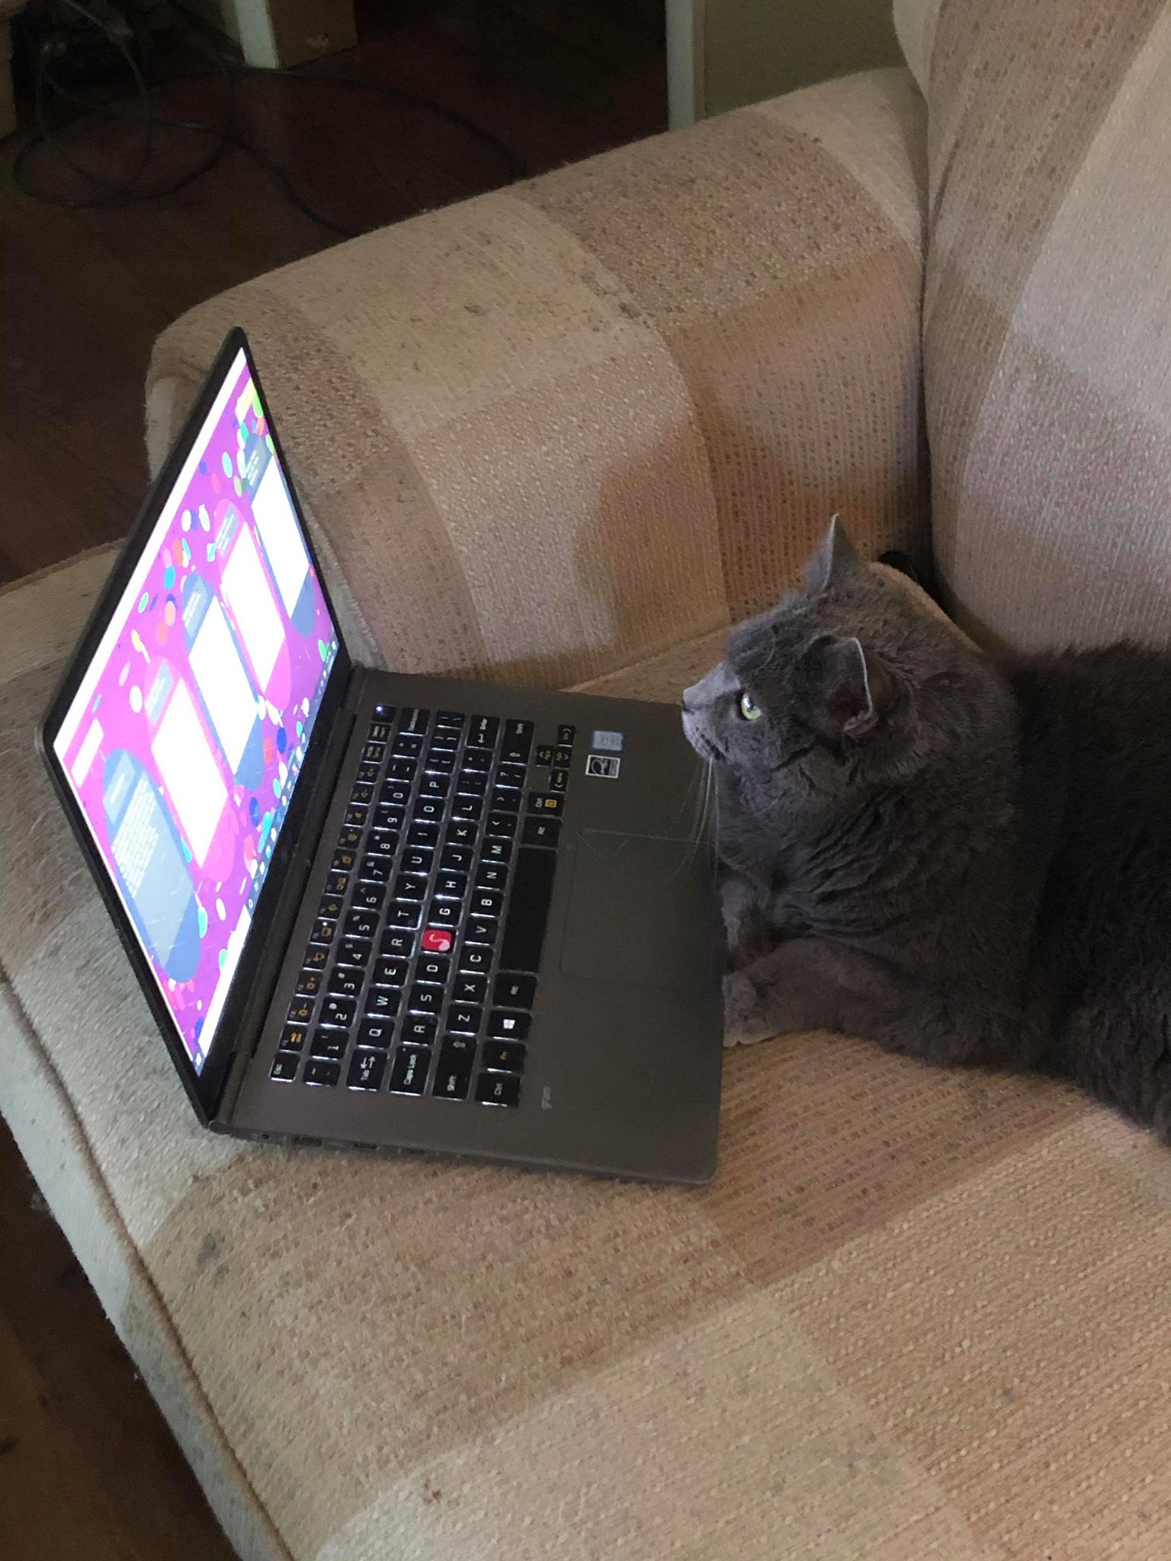
Let's take a Look at the cats
“This Program is biased against things without fingers! Wait,how I am speaking? Anyway, I say .6 stars!” - Gracie

Slide 47
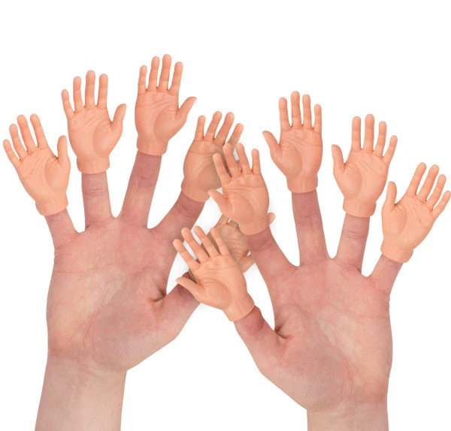
what did we do to With Gracie's Feedback?
We decided that things without fingers are not really our demographic. So, we didn’t change anything based on her feedback
Fingers for the win!

Slide 48
Usefulness of this application
Before we began the beta testing, we thought it did everything we had hoped for. It would recommend the Movies based on our liked and favorited movies and actors and provided us with an interesting map of the birthplace of the actors. However, the beta testers proved very useful. They were able to test how a realistic person would interact with the program. This allowed us to flesh out many more user bugs.
We wanted to make a database that a user could remove movies they never want to see again and also add movies to a liked list to promote similar movies. Upon inspection of the set it recommended a Movie for me I had not seen but would like to

Slide 49
Conclusion
Lesson learned from this project

Slide 50
Big Things that We have Learned
More Data/information is not always better
Populate the database early
GUI Frames Take a lot of minor adjustments
Clean data is very important
Sometimes the data sets are just too large to process

Slide 51
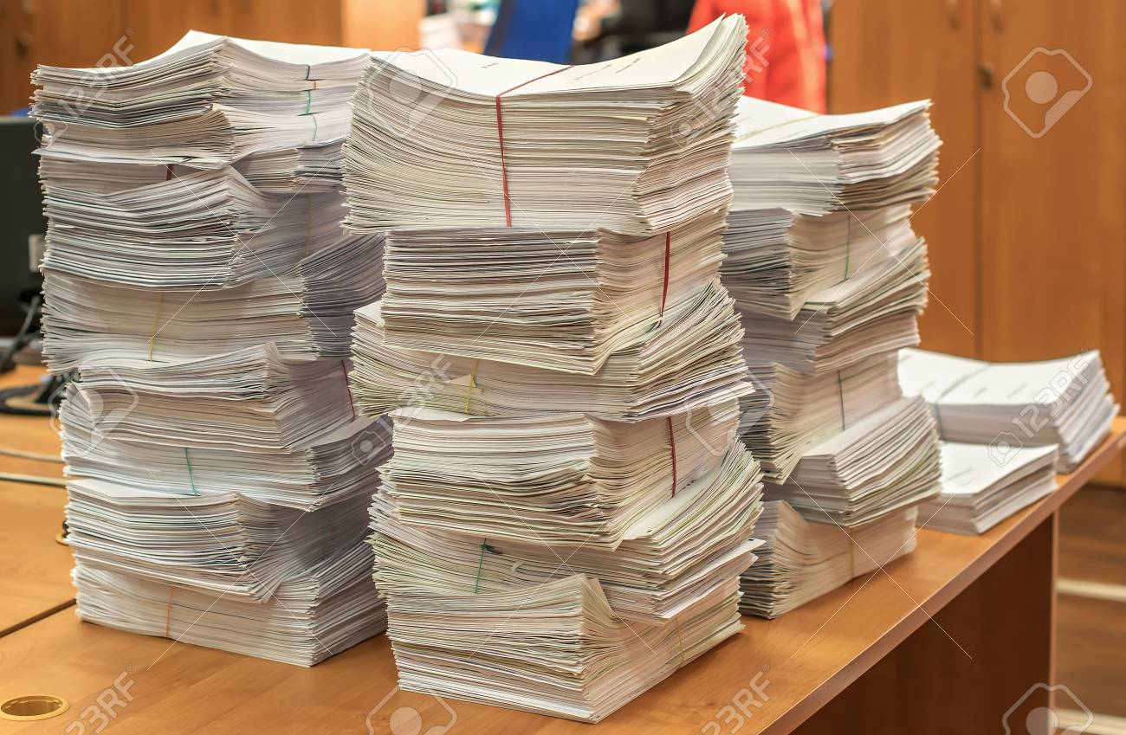
Too much Data?
We Started with so many attributes for each entity in the beginning. In the end we realized a lot of them were pointless and we ended up being removed

Slide 52

Too late to Populate?
We waited to populate the database until after we had completed many other aspects and the actual population/cleaning processes take time

Slide 53
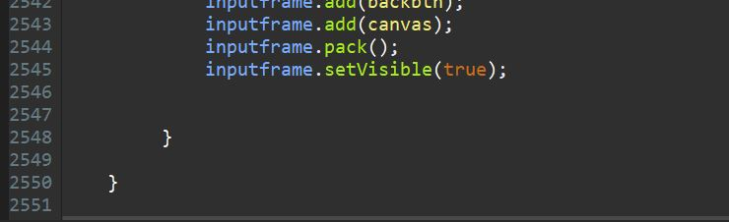
Too long and too messy
The GUI aspect need so much little detail like Moving things by pixels and it was just very time consuming.

Slide 54

Should have listened about the number of data sets
We chose to combine two data sets and that turned out to be nearly impossible with the time restriction.
We had to import other datasets just to merge these two together

Slide 55
Things Each OF US WOULD LIKE TO NOTE/LIKE
Logan
Allen
Joel
Every time you run the app it new because the colors and shapes are random
The map is just something extra is cool
I enjoy movies so this is something that i will probably use
Newfound appreciation of the speed of search engines
Learning interaction of Java front end to MySQL back end was very insightful
Funky UI is fun
Map feature
Connecting relatively separate datasets is difficult, but useful for the end user in the long run (house multiple domains of info in one place)

